Slide 1
Vehicle Detection
Arron Bao B. Van, Zhaozhuo (Alan) Li
CS484, Fall 2015

Slide 2
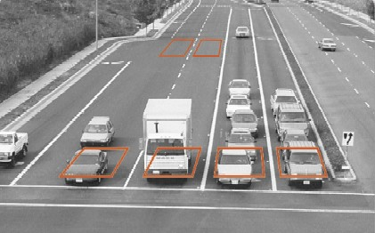
Problem: Detect Cars on Road
OpenCV
Background Subtraction, k-NN method
Simple Blob Detection

Slide 3
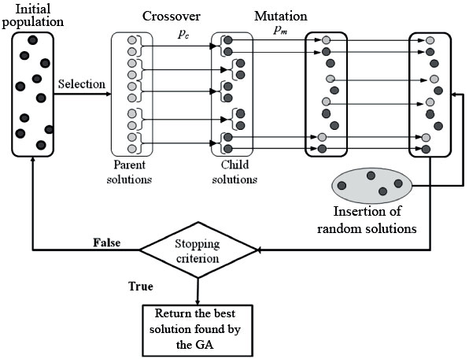
Problem 2: Blob Detection is meh
Don’t change methodology
Improve by changing blob detector parameters

Slide 4
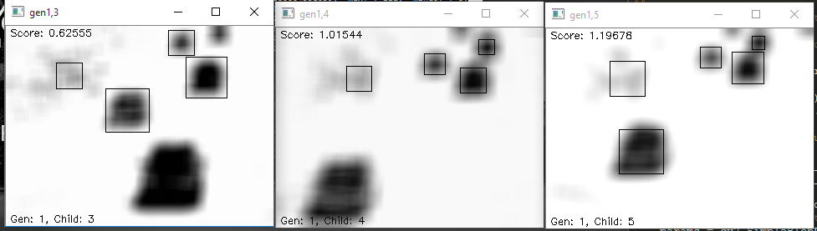
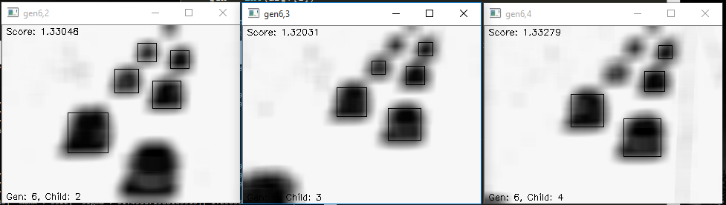
Results

Slide 5
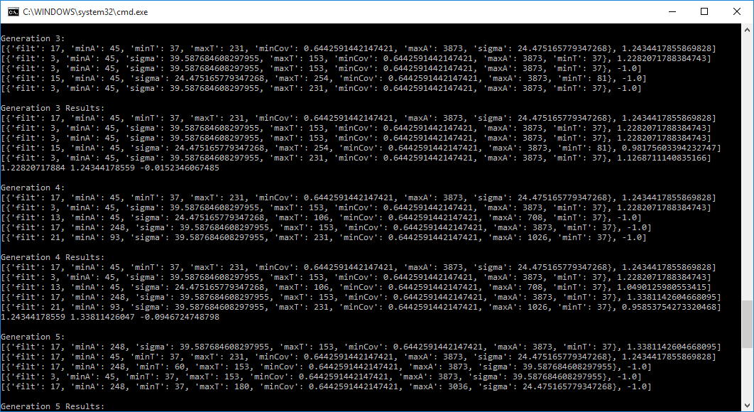
Results

Slide 6
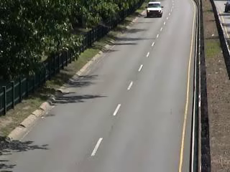
Results
http://www.changedetection.net/
https://github.com/Screensaver7/Genetic-Vehicle-Detection
10 generations with max population of 8.

Slide 7
Problems
This assumes that videos has efficient lighting and conditions…

Slide 8
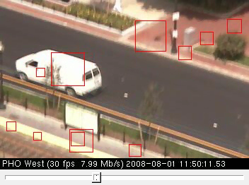
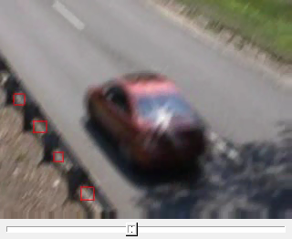
Problems
Shaking Camera

Slide 9
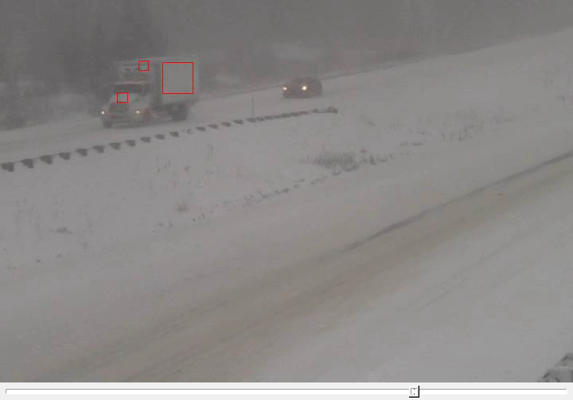
Problems
Bad Weather

Slide 10
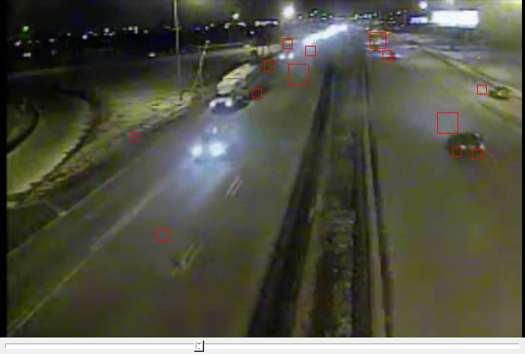
Problems
Dark Lighting

Slide 11
Work
Arron Bao B. Van – 35%, BG subtract, Blob Detect
Zhaozhuo Li – 65%, Bbox, Accuracy measurements, Genetic Algorithm, Report, Presentation
Pepperoni and pineapple pizza with sausages – Moral support

